Slide 1
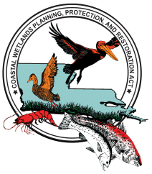
Coastal Wetlands Planning, Protection and Restoration Act Update
Thursday; July 21, 2011
Coastal Builders Coalition July Meeting

Slide 2


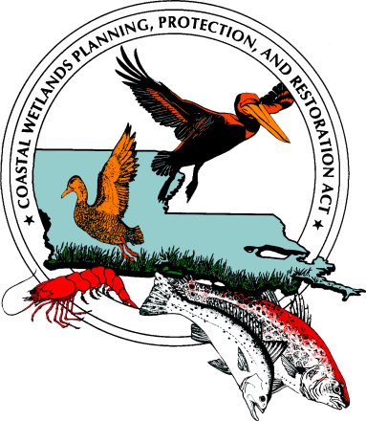




An Interesting Partnership Idea
U.S. Department of Interior -
U.S. Fish and Wildlife Service
U.S. Department of Commerce – NOAA, National Marine Fisheries Service
U.S. Department of Agriculture - Natural Resources Conservation Service
U.S. Department of the Army - U.S. Army Corps of Engineers
U.S. Environmental Protection Agency
Louisiana Governor’s Office

Slide 3
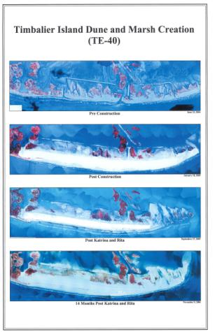
Additional Partners
Local Governments/Coastal Zone Managers (CZM)
Land Owners
Contractors
Business and Industry
  Oil and Gas
  Navigation
  Fishermen/women
Legislators
Non Governmental Environmental Agencies
Sportsman/women
Media
Educators
Public Spokesmen/women
Volunteers

Slide 4
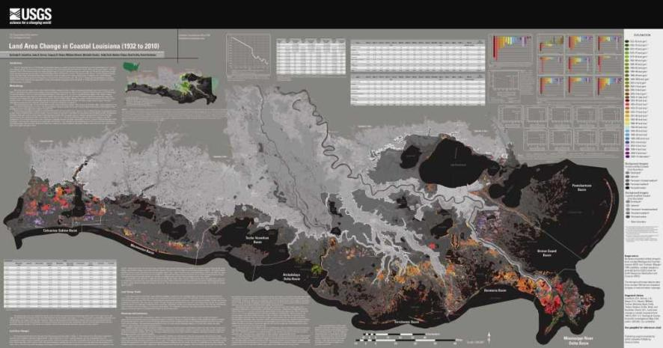
The Needs are Great.
On average, Louisiana loses a football field of wetlands every hour.

Slide 5
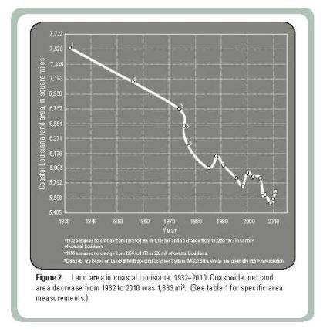
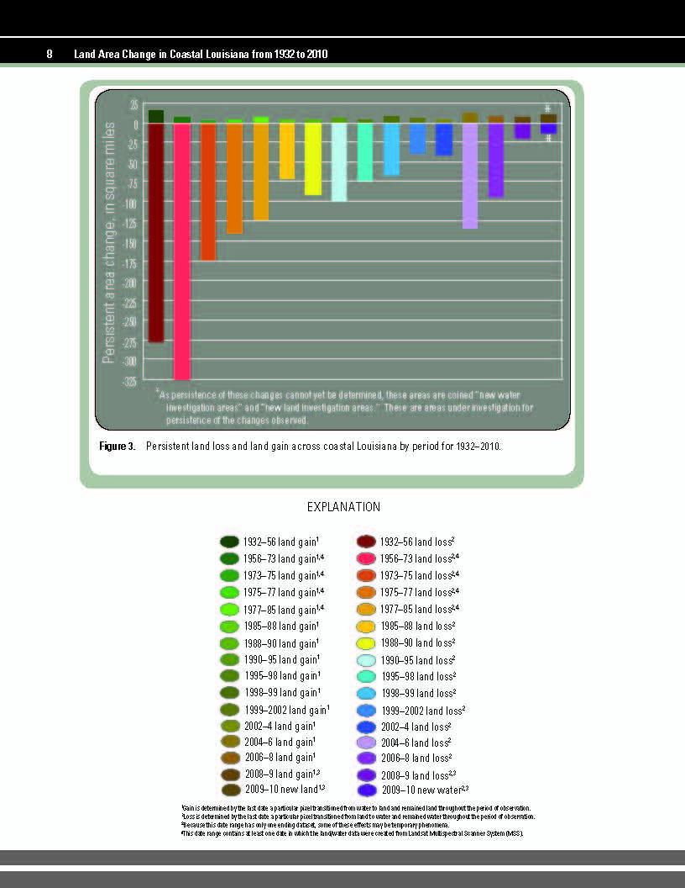
Data from the Map:

Slide 6
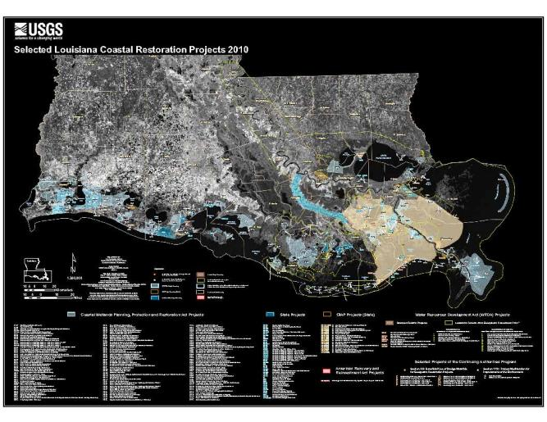
The Ideas for Restoration Are Greater.

Slide 7
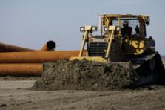
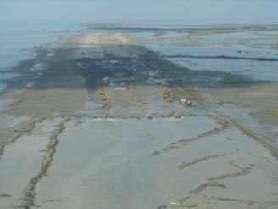
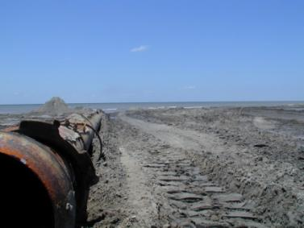
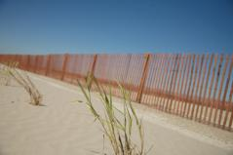
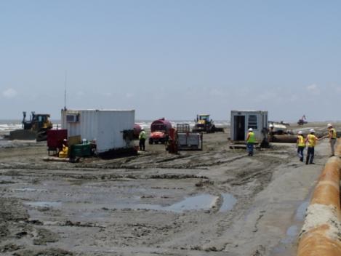
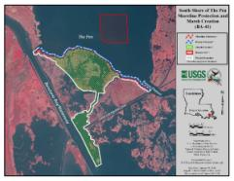
CWPPRA
Pipe
Delivering
Sediment
Providing Coastal Restoration Since 1990

Slide 8
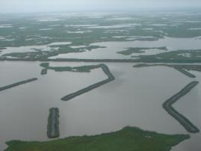
CWPPRA at
Work
Total CWPPRA Projects: 149
Completed CWPPRA Projects: 91
CWPPRA Projects Under Construction: 11
CWPPRA Projects in Engineering and Design: 47 (with 8 of the 47 scheduled for construction in FY2011)
Since 1990, the net Louisiana wetland area that has been protected, created, or restored is 110,000 acres (greater than 550,000 acres have also been enhanced)
Shoreline Protection
Barrier Island Restoration
Marsh Creation using Dredged Material
Freshwater Reintroduction
Sediment Diversion
Hydrologic Restoration
Marsh Management
Sediment and Nutrient Trapping
Terracing
Outfall Management
Vegetative Planting

Slide 9
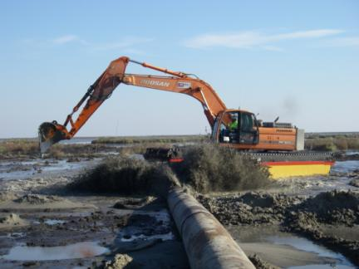
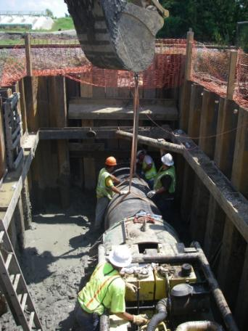
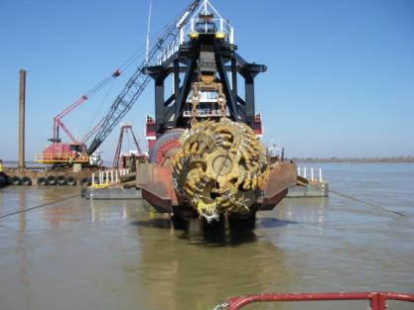
Green Jobs?
You bet.

Slide 10
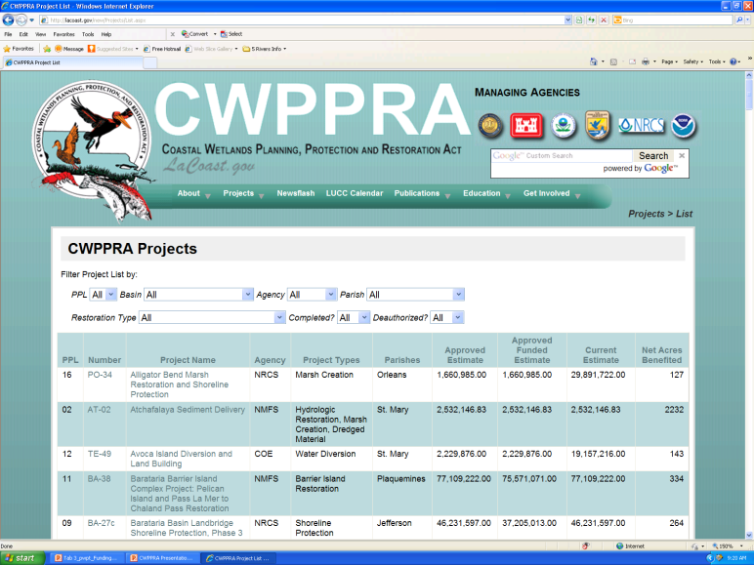
www.LaCoast.gov

Slide 11
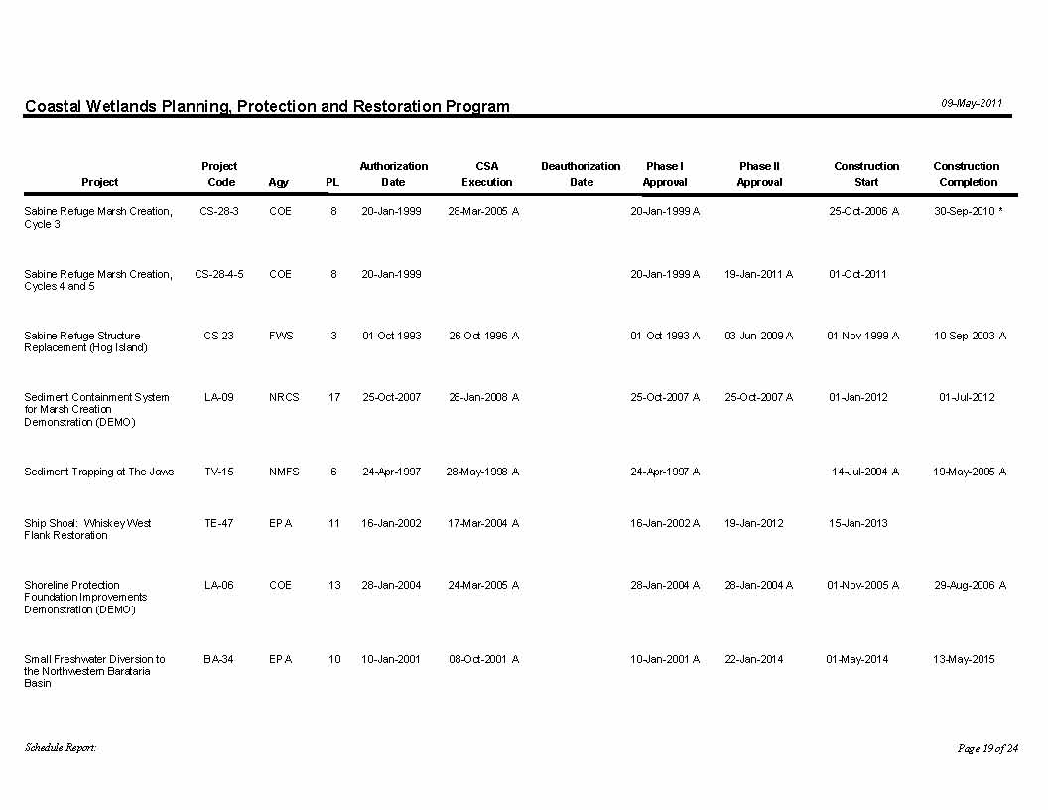
CWPPRA Project Schedule
Note Agency, Phase I Approval, Phase II Approval, Construction Start Date
On LACoast.gov site under Projects

Slide 12
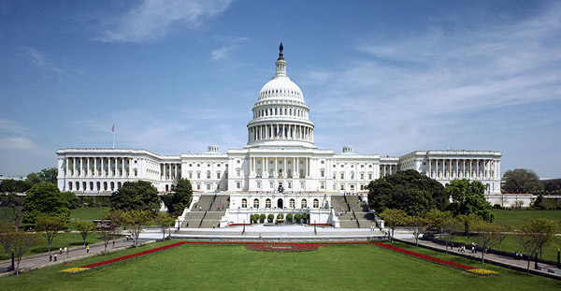
CWPPRA Legislation
CWPPRA ACT - PL 101-646, Title III 2. 1990 George Bush Signed the Bill
Authorization History:
(1) CWPPRA ORIGINAL AUTHORIZATION: Nonindigenous Aquatic Nuisance Prevention and Control Act of 1990 (Public Law 101-646, Title III, dated 29 Nov 1990) Authorized CWPPRA through 1999.
(2) CWPPRA 2nd AUTHORIZATION: Departments of Veterans Affairs and Housing and Urban Development, and Independent Agencies Appropriations Act, 2000 (Public Law 106-74, Title IV, General Provisions, dated 20Oct1999) SEC. 430. Section 4(a) of the Act of August 9, 1950 (16 U.S.C. 777c(a)), is amended in the second sentence by striking “1999” and inserting “2000”.”
(3) CWPPRA 3rd AUTHORIZATION: Fish and Wildlife Programs Improvement and Nation Wildlife Refuge System Centennial Act of 2000 (Public Law 106-408, Section 123, dated 01 Nov 2000)
SEC. 123. Section 4(a) of the Dingell-Johnson Sport Fish Restoration Act (16 U.S.C. 777c(a) is amended in the second sentence by striking “2000” and inserting “2009”.”
(4) CWPPRA 4th AUTHORIZATION: Consolidated Appropriations Act (Public Law 108-447, Division D, Title X, Section 114, dated 08Dec2004) Sec. 114. Coastal Wetland Conservation Project Funding.
PERIOD OF AUTHORIZATION. ─ Section 4(a) of the Dingell-Johnson Sport Fish Restoration Act 16 U.S.C. 777c (a) is amended in the second sentence by striking “2009” and inserting “2019”.”

Slide 13
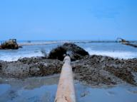
CWPPRA Legislative
Funding History:
(1) CWPPRA ORIGINAL FUNDING: Omnibus Budget Reconciliation Act of 1990 (Public Law 101-508, Title IX, Section 11211, dated 05 Nov 1990, effective 01 Dec 1990)
Provided dedicated funding for CWPPRA via the transfer of small engine fuel taxes from the Highway Trust Fund to the Sport Fish Restoration Account through FY94, thus providing CWPPRA with funds through FY95.
(2) CWPPRA 2nd FUNDING: Intermodal Surface Transportation Efficiency Act of 1991 (Public Law 102-240, Title VIII, Section 8002, dated 18 Dec 1991)
Provided dedicated funding for CWPPRA via the transfer of small engine fuel taxes from the Highway Trust Fund to the Sport Fish Restoration Account through FY98, thus providing CWPPRA with funds through FY99.
(3) CWPPRA 3rd FUNDING: Transportation Equity Act for the 21st Century (Public Law 105-178, Title IX, Section 9002, dated 09 Jun 1998)
Provided dedicated funding for CWPPRA via the transfer of small engine fuel taxes from the Highway Trust Fund to the Sport Fish Restoration Account through FY05, thus providing CWPPRA with funds through FY06.
(4) CWPPRA 4th Funding: Safe, Accountable, Flexible, Efficient Transportation Equity Act: A Legacy for Users (SAFTEA LU) (Public Law 109-59, Title XI, Section 11101, dated 10Aug2005)
Provided dedicated funding for CWPPRA via the transfer of small engine fuel taxes from the Highway Trust Fund to the Sport Fish Restoration Account through FY11, thus providing CWPPRA with funds through FY12.

Slide 14
Funding Graph

Slide 15
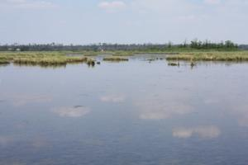
Funding Totals
Funding Summary | Federal | non-Federal | Total Program
Thru FY11 | $ 1,139,602,004 | $ 192,497,248 | $ 1,332,099,252
Thru FY20 | $ 1,972,317,912 | $ 331,505,938 | $ 2,303,823,850

Slide 17
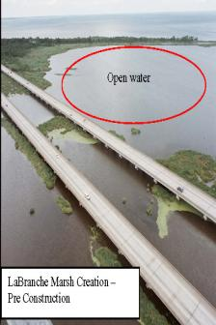
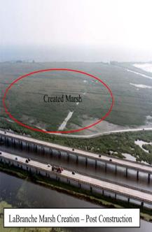
CWPPRA Funding Issues
This federal legislation was first enacted in 1990 and is authorized through 2019.
Its funding source, the Sport Fish Restoration and Boating Safety Trust Fund, has not been reauthorization since expiring in October 2009.
CWPPRA is currently being continued by Congressional continuing resolution. Current CWPPRA funding for new construction projects will likely only continue for an additional two to three years.

Slide 18
Total Funding Required
(for projects for which construction has started)
The overall funding limits of the program should be considered when approving projects for construction
Once a project begins construction, the program should provide OM&M over 20 year life of project
  - PPL1-8 projects have funding for 20 years already set aside
  - PPL9+ projects set aside funds in increments: Ph I/ construction + 3 yrs OM&M/ yearly OM&M thereafter
Total funds into the total program (Fed/non-Fed) over life of program (FY92-20) = $2,387.7M

Slide 19
Additional Funding Information
The total cumulative obligation to-date is $1 billion; of that, CWPPRA has spent $737 million. CWPPRA is a $2.5 billion program over its 29-year authorization period.

Slide 20
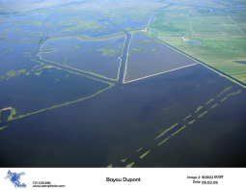
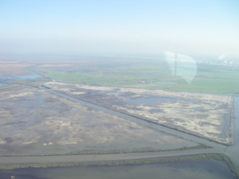
Before
Without the trust fund’s renewal, the nature of CWPPRA’s future work is in question.
This federal funding source has been matched at a rate of 15% by Louisiana and is an effective way to meet the urgent need for on-the-ground coastal restoration.
After
Project Example:
Bayou Dupont

Slide 21
Sharing Information
Target Audiences
  Stakeholders
  Environmental Groups
  Legislative Delegates
    Local, State, and Federal
  Media
  CWPPRA Partners - National Agency
  Restoration Businesses/Community
  Business and Community Leaders
    Rotary
    Chamber of Commerce Groups

Slide 22
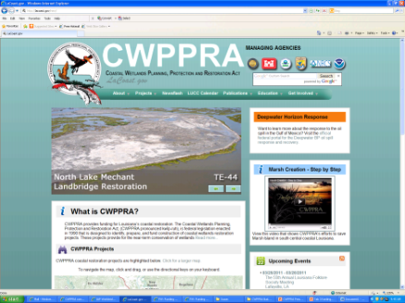
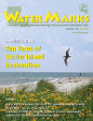
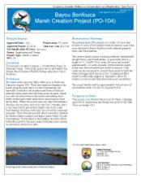
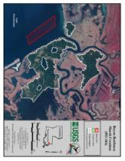
Tools You Can Use to Help CWPPRA
Website
  LaCoast.gov
WaterMarks Magazine
YouTube Short Movies
“Partners In Restoration”
CWPPRA One Page Summary
CWPPRA Fact Sheets
Your Knowledge

Slide 23
Additional Information
General Information about CWPPRA www.LACoast.gov
Program Administration www.mvn.usace.army.mil/pd/cwppra_mission.htm
Outreach Staff:
Dr. Scott Wilson, CWPPRA Public Outreach Chairman
Susan Testroet-Bergeron, CWPPRA Outreach Coordinator
Cole Ruckstuhl, CWPPRA Media Specialist

Slide 24
Contact Information
Susan Testroet-Bergeron
BergeronS@USGS.gov
www.LaCoast.gov
337-266-8623

